Slide 1
Data Warehousing
Lecture-1
Introduction

Slide 2
Reference Books
W. H. Inmon, Building the Data Warehouse
(Second Edition), John Wiley & Sons Inc., NY.
Paulraj Ponniah, Data Warehousing Fundamentals,
John Wiley & Sons Inc., NY.

Slide 3
The need
Data: Data is defined as numerical or other facts represented or recorded in a form suitable for processing by computers. Information: is processed data that is meaningful. For example the current balance, items sold, money made etc. Knowledge: Knowledge, is an application of information and data.

Slide 4
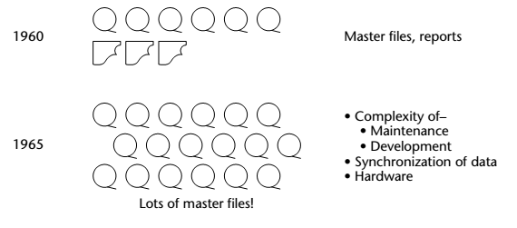
Historical overview

Slide 5
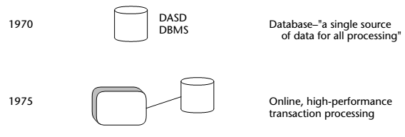
Historical overview
Notes:
DASD: disk storage
DBMS: The purpose of the DBMS was to facilitate the programmer to store and access data on DASD.
We started run queries.

Slide 6
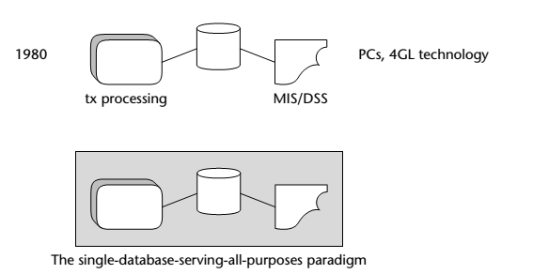
Historical overview
Notes:
MIS: is designed for the efficient processing of data or information. used by lower, middle or upper level management.
DSS: is designed to provide effective analysis relevant to specific situations. support to analysts and decision makers.
While an MIS simply gathers data, a DSS manipulates that data and helps to develop tools that aid in the decision-making process.
Need of such Tool and tech which can be used without prog knowledge.

Slide 7
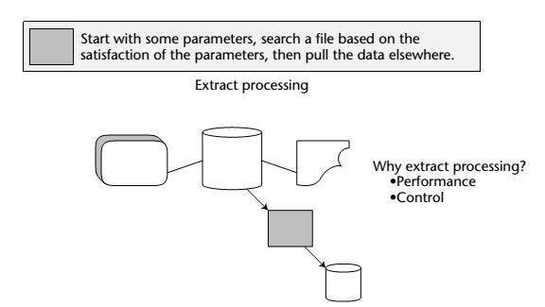

Historical overview
Notes:
Not only many systems made, mis made, dbs made but replication of data started. Besides this coherence issue started and a problem arises of crisis of credibility.

Slide 8
The Evolution
The need to synchronize data upon update
The complexity of maintaining programs
The complexity of developing new programs
The need for extensive amounts of hardware to support all the master files

Slide 9
Historical overview: Crisis of Credibility

What is the financial health of our company?
??





-10%

+10%


Slide 10
Crisis of Credibility
Department-A which uses a different set of data sources, external reports etc. as compared to Department-B comes with a different answer sales up by 10%, as compared to the Department-B i.e. sales down by 10%.
This is a typical example of the crisis in credibility because both departments got different view of the business using different sources.

Slide 11
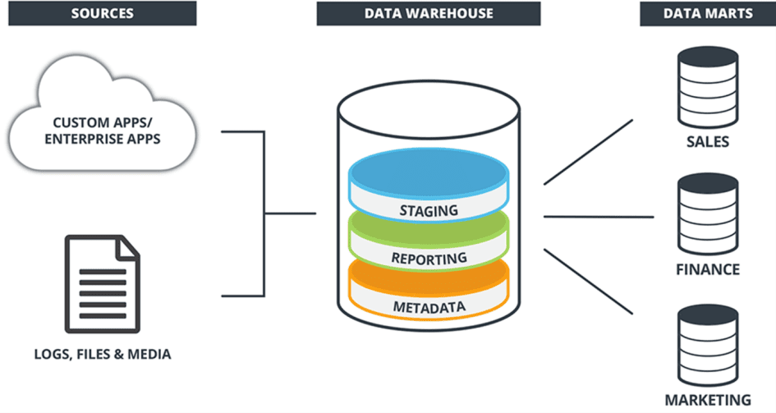
What is a Data Warehouse?
A data warehouse is a relational database system businesses use to store data for querying and analytics and managing historical records. It acts as a central repository for data gathered from transactional databases.

Slide 12
What is a Data Warehouse?
A complete repository of historical corporate data extracted from transaction systems that is available for ad-hoc access by knowledge workers.
Notes:
45

Slide 13
What is a Data Warehouse?
Complete repository • All the data is present from all the branches/outlets of the business. • Even the archived data may be brought online. • Data from arcane and old systems is also brought online.
Transaction System
Management Information System (MIS)
Could be typed sheets (NOT transaction system)
Ad-Hoc access
Dose not have a certain access pattern.
Queries not known in advance.
Difficult to write SQL in advance.
Notes:
45

Slide 14
Another Definition:
A data warehouse is a subject-oriented, integrated, time-variant and non-volatile collection of data in support of management's decision making process.
Notes:
45

Slide 15
Characteristics of Data warehouse
Data Warehouse Concepts have following characteristics:
Subject-Oriented
Integrated
Time-variant
Non-volatile

Slide 16
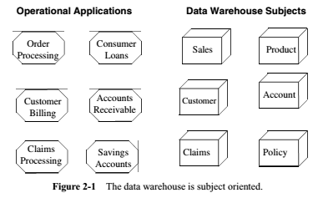
What is a Data Warehouse?
Subject oriented: A data warehouse can be used to analyze a particular subject area. For example, sales, customer, products can be a particular subject.
Notes:
45
The goal of data in the data warehouse is to improve decision making,
Why subject oriented?

Slide 17
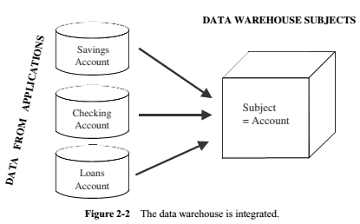
What is a Data Warehouse?
Integrated:
loaded from different sources that store the data in different formats.
checked, cleansed and transformed into a unified format to allow easy and fast access.
Notes:
45
The goal of data in the data warehouse is to improve decision making,

Slide 18
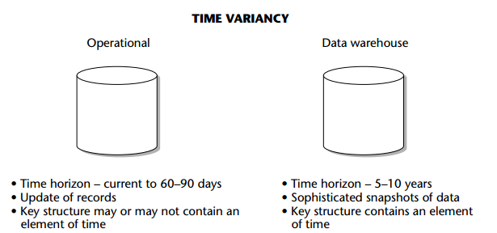
What is a Data Warehouse?
Time variant:
-Historical data is kept in a data warehouse. - records that are created as of some moment in time.
-data warehouse as the data is loaded; the moment becomes its time stamp.
Notes:
45
For example, a transaction system may hold the most recent address of a customer, where a data warehouse can hold all addresses associated with a customer.

Slide 19
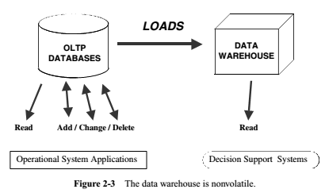
What is a Data Warehouse?
Non-volatile: after insertion data is neither changed nor removed.
Notes:
45
Non volatile: Data updates are commonplace in an operational database; not so in a data warehouse. The data in a data warehouse is primarily for query and analysis.

Slide 20
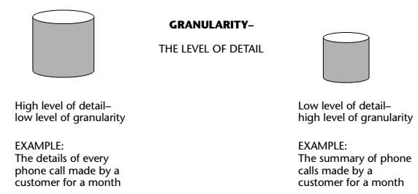
What is a Data Warehouse?
Granularity
Data granularity in a data warehouse refers to the level of detail.
Notes:
45

Slide 21
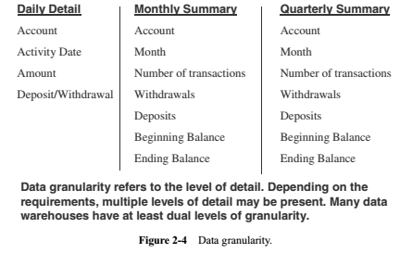
THREE DATA LEVELS IN A BANKING DATA WAREHOUSE
Notes:
45

Slide 22
OLAP & OLTP
OLAP (Online analytical processing) | OLTP (Online transaction processing)
Conducts complex data analysis for smart decision making | Conducts large transactions by multiple users in real-time
Designed for use by data scientists and knowledge workers | Designed for frontline workers such as bank tellers, cashiers, and front desk officials
Data source has multiple schemas to support complex queries from current and historical data | Relies on traditional database management systems to accommodate massive data volumes in real-time transactions
Requires read-intensive workloads and involves large data sets | Workloads are based on simple read-and-write operations via Structured Query Language (SQL)

Slide 23
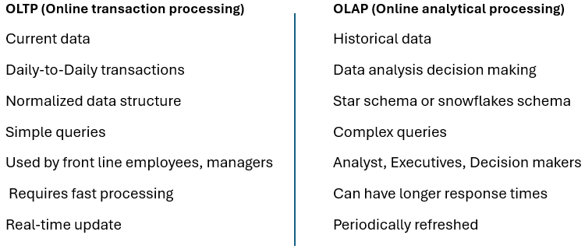
OLAP & OLTP (cont..)

Slide 24
Activity
Example Scenarios:
Scenario 1: A bank processes a customer's withdrawal request in real-time. (?)
Scenario 2: An executive analyzes sales data from the past year to decide on next season’s inventory. (?)
Scenario 3: A hospital updates a patient's record after a check-up. (?)
Scenario 4: A marketing team analyzes customer purchasing patterns over the last five years to tailor future promotions. (?)

Slide 25
Activity
Example Scenarios:
Scenario 1: A bank processes a customer's withdrawal request in real-time. (OLTP)
Scenario 2: An executive analyzes sales data from the past year to decide on next season’s inventory. (OLAP)
Scenario 3: A hospital updates a patient's record after a check-up. (OLTP)
Scenario 4: A marketing team analyzes customer purchasing patterns over the last five years to tailor future promotions. (OLAP)

Slide 26
Purpose
To store historical data in an organized form to facilitate data analysis and reporting.

Slide 27
scope
Stores data from multiple sources.

Slide 28
Data warehouse benefits
Data warehouses provide many benefits to businesses. Some of the most common benefits include:
Provide a stable, centralized repository for large amounts of historical data
Improve business processes and decision-making with actionable insights
Increase a business’s overall return on investment (ROI)
Improve data quality
Enhance BI performance and capabilities by drawing on multiple sources
Provide access to historical data business-wide

Slide 29
Why a Data Warehouse (DWH)?
Data recording and storage is growing.
History is excellent predictor of the future.
Gives total view of the organization.
Intelligent decision-support is required for decision-making.
Notes:
48
Data storage capacity is increasing. Cost is reducing. To store data is relatively easy.
when u apply for job u give ur cv..so in dwh we take past and look future. But impt thing is this u not just take the past u take domain knowledge and mind to predict future.
whole view of organization. E.g bank has variety of customers, all belong to same bank. Insurance company
bank is losing customers

Slide 30
Reason-1: Why a Data Warehouse?
Size of Data Sets are going up .
Cost of data storage is coming down .
The amount of data average business collects and stores is doubling every year
Total hardware and software cost to store and manage 1 Mbyte of data
1990: ~ $15
2002: ~ ¢15 (Down 100 times)
By 2007: < ¢1 (Down 150 times)

Slide 31
Reason-2: Why a Data Warehouse?
DBMS Approach
List of all items that were sold last month?
List of all items purchased by Sana?
The total sales of the last month grouped by branch?
How many sales transactions occurred during the month of January?
Notes:
They are either about listing the contents of tables or running aggregates of values i.e. rather simple and straightforward queries and fairly easy to program.
The queries follow rather pre-defined paths into the database and are unlikely to come up with something new or abnormal.

Slide 32
Reason-2: Why a Data Warehouse?
Intelligent Enterprise
Which items sell together? Which items to stock?
Where and how to place the items?
What discounts to offer?
How best to target customers to increase sales at a branch?
Which customers are most likely to respond to my next promotional campaign, and why?

Slide 33
Reason-3: Why a Data Warehouse?
Businesses want much more…
What happened? (Descriptive analysis)
Why it happened? (Diagnostic analytics)
What will happen? (Real-time analytics)
What is happening? (Predictive analytics)
What do you want to happen? (prescriptive analytics)
Stages of
Data Warehouse

